Slide 1


Linked
Presentation
Team-”UDYAM-GGITS”

Slide 2
Introduction
CONTENTS:-
○ What is LinkedIn?
○ Why Do we need it?
○ Company Overview
○ History
○ Sustainability of the company

Slide 3
What is LinkedIn?
LinkedIn is an American business and employment-oriented online service, Launched on May 5, 2003, it is mainly used for professional networking, including employers posting jobs and job seekers posting their CVs.
Since December 2016 it has been a wholly owned subsidiary of Microsoft.

Slide 4
Why do we need it?
LinkedIn gives you the ability to showcase your profile, expertise, recommendations
and connections and o demonstrates credibility in your industry and highlights your achievements.
A whopping 87% of recruiters find LinkedIn to be the most effective when vetting candidates during the hiring process – especially those under 45 (90%).

Slide 5
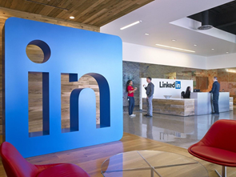
Company Overview
CEO of LinkedIn is Ryan Roslansky Reid Hoffman, founder of LinkedIn, is Chairman of the board. The site has an Alexa Internet ranking as the 57th most popular website (May 2020).

Slide 6
History
The company was founded in December 2002 by Reid Hoffman and founding team members from PayPal and Socialnet.com. In August 2004, LinkedIn reached 1 million users. In March 2006, LinkedIn achieved its first month of profitability. In April 2007, LinkedIn reached 10 million users.

Slide 7
History
In 2008, linkedin launch their own mobile version of their site.
In 2011, LinkedIn earned $154.6 million in advertising revenue alone, surpassing Twitter, which earned $139.5 million.
On June 13, 2016, Microsoft announced that it would acquire LinkedIn for $196 a share, a total value of $26.2 billion and the largest acquisition made by Microsoft to date

Slide 8

Sustainability
The economic graph was to be built on the company's current platform with data nodes including companies, jobs, skills, volunteer opportunities, educational institutions, and content.
LinkedIn has used economic graph data to research several topics on the job market, including popular destination cities of recent college graduates ,areas with high concentrations of technology skills, and common career transitions.

Slide 9
“LinkedIn is not just a way to find your dream job, but a way to be better at the job you already have.”
-Jeff Weiner
CEO LinkedIn

Slide 10
LinkedIn in detail
CONTENTS:-
○ About The Platform
○ Features
○ Extensions

Slide 11
About The Platform
LinkedIn is a platform that was born as a social network for professionals and companies. Its main objective is to put people in contact who are looking for work synergies and new professional or business opportunities.
It consists of :
● Login/sign up page
● Home Page
● Network Page
● Chat Section
● Notifications
● Search Jobs

Slide 12
Features
1. Home: The home page showing recent posts from your connection with other professionals and company pages you are following.
2. Profile: Profile section show all about you like profile picture, background,your name at the top and below it shows about your work experience,education ,summary and many other things.
3. My network: In this section, you will find out the number of connection you have made with other professionals.
4. Jobs All jobs are posting in linkedin by employers and all are sorted according to your summary,skills and others, according to your profile.

Slide 13

5. Messages: In this section,you can chat with other professional privately and also you can share Files,attachment,photos,videos and more.
6.Search Bar: Linkedin have filtered type search bar that allows you to search specifically according to your need and also contain feature of QR code
7..Notification: This feature let you know about when you have any endorsement,pending joinings and messages.
8.Interests: You can follow certain interests in linkedin like company pages.

Slide 14
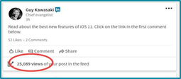
Extensions
Extension are module of chromes that enhance and give more feature to work on LinkedIn efficiently.
Some of them are:
Lempod: Lempod help you 10X your linkedIn post and you can reach more audience than before.
Shield Analytics: It allows you to analyse your profile and posts.

Slide 15
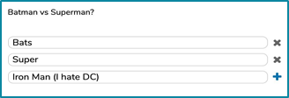
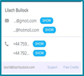
3.Polls for LinkedIn This extension is used to create a poll for your audience, if you want to ask something from audience and It is free extension.
4. Lusha This extension is used is used to find emails and phone number of almost everyone in LinkedIn that helps you to get information about professional.

Slide 16
USAGE
Contents:-
○ How to use it?
○ How to make it more attractive?
○ Ways to use it fruitfully!

Slide 17
How to use LinkedIn?
Make a findable and visually appealing profile.
Use your linkedIn profile to showcase everything that doesn’t fit your resume.
Stay ACTIVE, on the site.

Slide 18
Maps
our office

Slide 19
660,000,000
+
REGISTERED USERS!
Whoa! That’s a big number!

Slide 20

THE NEED OF MENTORSHIP
In terms of learning, you can learn from different experts by making them your mentor.
For example, if you belong to a private institute and need guidance from a IIT faculty, you can simply make connections to them and sending message and asking them to help you in project making or in any type research work.

Slide 21
ALUMNI TOOL
It’s an easy way to explore people who graduated from your same school, where they work now and in what cities (among other things). Connecting with alumni is a super simple and effective way to find your way into a new job.
Suggestions:
To get involved in a collaboration In terms of networking, for example if you want to make a project and you don’t have the time to do it alone, you can seek another person that may help or collab with you to make that project. This will save your time and you will be able to make a nice project.

Slide 22
89,526,124$
185,244 users
100%
That’s a lot of money
And a lot of users
Total success!

Slide 23
How to use it?
Make a easily searchable and visually appealing profile .
Use your linkedIn profile to showcase everything that doesn’t fit your resume.
When your profile is ready, strategically connect with others .
Once you have got a valuable network ,snoop.
Stay ACTIVE, on the site.

Slide 24
How to make it more attractive?
Uploading a good picture
A professional headshot reflects your personal brand.
Profile with a picture get 15 times more profile views.
Use a recent and high quality photo.
Proper headline
A catchy headline captures the curiosity of LinkedIn members.
Highlighting your specialities here helps to increase your search rankings.
Summary
This section has a 2000 character limit. Make it count.
Summary can sum up your professional history,qualification,and personality and what makes you unique.
Customize your background photo
It will help you to brand yourself.
It allows you to reference your linkedin page easily in your resume,business cards and other documents.

Slide 25
Ways to use it fruitfully!
Optimize your profile:
-Create a keyword rich headline that rocks.
-Add a professional headshot.
-Write a summary.
-Include your e-mail address and other contact info.
Establish your LinkedIn presence:
-Regularly connect with new people to build your network. Coworkers, supervisors, professors etc.
-Join professionals groups.
-Add value by sharing useful industry specific content
Reference LinkedIn in your physical resume:
-Create a custom URL to make your profile easier to share.
-Lead recruiters and hiring managers to your linkedin profile to view:
★ Recommendations ★ Portfolio sample
Use LinkedIn’s jobs search feature:
-Create job alerts to have new jobs emailed to you.
-Review privacy settings to keep your search under wraps.

Slide 26

SHOW YOUR SKILLS
“Schooling doesn't assure employment but skill does.”
Highlight your top skills.
Mention at least 5 relevant skills.
Take assessment and earn badges to verify your skills.
By mentioning your top skills it increases your chance to appear on search by 31 times.
People with badges have 30% more chance to be hired by the recruiters.

Slide 27

SHOW YOUR ACHIEVEMENTS
“If you put off everything till you're sure of it, you'll never get anything done.”
Highlight your best accomplishments.
Add your company websites and projects you’ve worked on.
Show your best skills relevant to the industry demand.
Ask your teammates to write about your work experience with them on your profile.

Slide 28
APPLICATIONS
CONTENTS:-
○ How is it useful for People?
○ Success rate of the app
○ Mind blowing Facts about linkedin
○ Maps & Statistics ○ Linkedin in a Nutshell

Slide 29
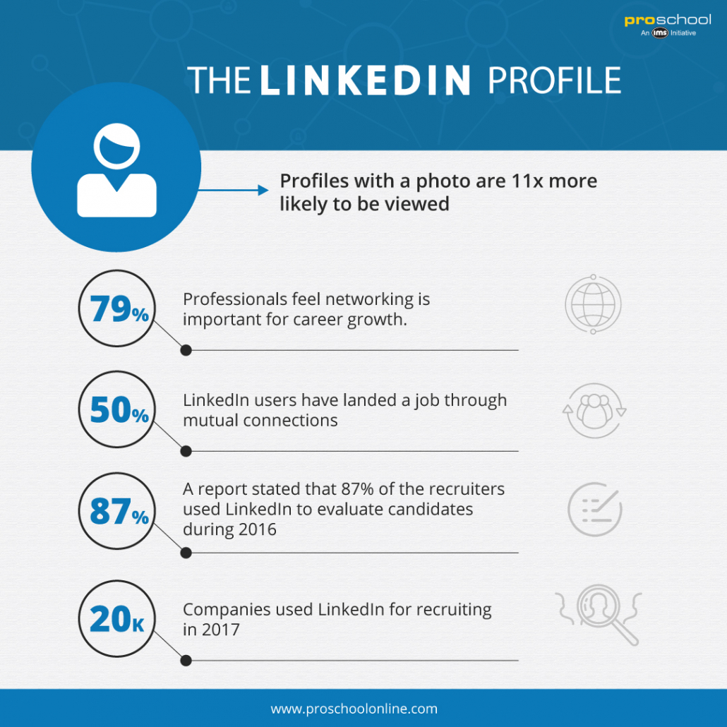
HOW IS IT USEFUL FOR PEOPLE?
1. Gain exposure to Hiring Managers and Recruiters. 93% of recruiters use LinkedIn to research and recruit candidates.
2. Demonstrate your knowledge, credibility and leadership expertise.
3. Use LinkedIn as a research tool.
4. Recognition Through Badges: LinkedIn Skill Assessments

Slide 30
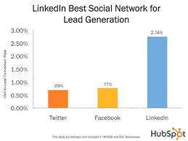
SUCCESS RATE OF LINKEDIN
LinkedIn is an especially good source for discovering leads. Hubspot found that LinkedIn is 277% more effective at generating leads than Facebook and Twitter.
Given this, it’s no surprise that 79% of marketers see LinkedIn as a very good source of leads, with 43% of marketers saying they have sourced at least one customer from LinkedIn. That number increases for B2B marketers, who report that 80% of their social media leads come from LinkedIn.

Slide 31
MIND-BLOWING FACTS ABOUT LINKEDIN
● Facebook may be the largest social networking site in the world today, but LinkedIn has been supporting its users for a longer time period.
● LinkedIn has over 575+ million users, with more than 260 million monthly active users ,Of those 40% access it on a daily basis.
● 44% of LinkedIn users take home more than $75,000 per year.
● Microsoft, recognizing the value of LinkedIn, acquired the company for $26.2 billion in 2016.
● Content on the LinkedIn feed receives about 9 billion impressions per week.
● LinkedIn is an especially good source for discovering leads. Hubspot found that LinkedIn is 277% more effective at generating leads than Facebook and Twitter.

Slide 32

S
T
A
T
I
S
T
I
C
S
The countries with the most LinkedIn users:-
● United States with 74 million members.
● India with 18 million members.
● United Kingdom with 11 million members.
● Brazil with 11 million members.
● Canada with 7 million member.

Slide 33
Roadmap
PROFILE PHOTO
SKILLS
REGULAR UPDATING
1
3
5
2
4
6
ACHIEVEMENTS
DESCRIPTION
BEING ACTIVE

Slide 34
LINKEDIN IN A NUTSHELL !!
➢ LinkedIn is a social networking website for people in professional jobs.
➢ The company started in December 2002, and the website opened May 5, 2003.
➢ Users can make connections with other people they have worked with, post their work experience and skills, look for jobs, and look for workers.
➢ The site is available in many languages, including most European languages, Japanese, Korean, Indonesian, and Malay.
➢ LinkedIn has more than 200 million members around the world.
➢ The company which owns LinkedIn, the LinkedIn Corporation, was bought out by Microsoft in 2016 for US$26 billion.

Slide 35








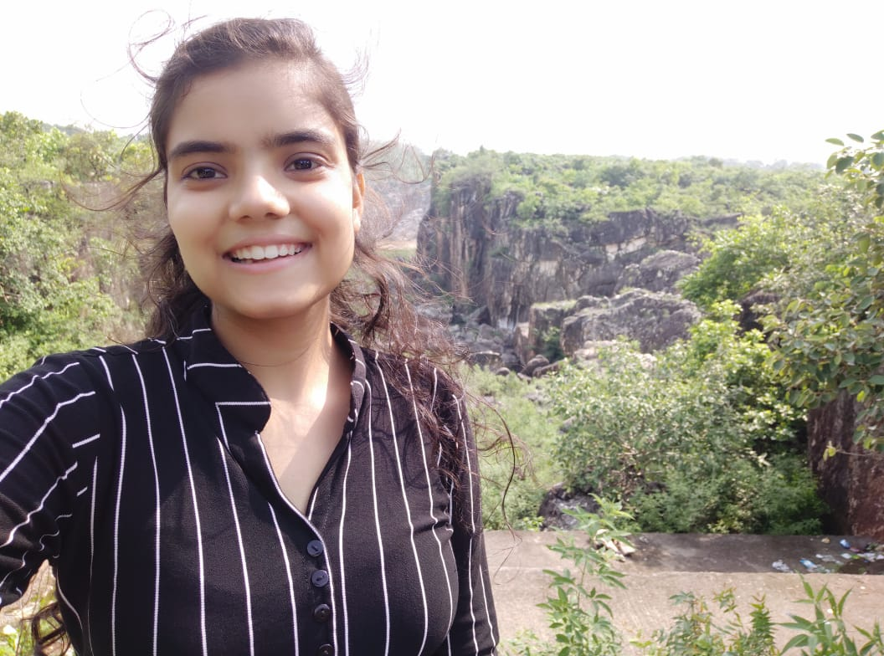

Our LinkedIn Profiles
Ashutosh Pandey - https://www.linkedin.com/in/ashutosh-pandey-486ba01b5
Kashish Beotra - https://www.linkedin.com/in/kashish-beotra-370bb61b6
Apurv Prakash Shrivastav https://www.linkedin.com/in/apurv-prakash-shrivastava-71a11b138/
Ankita Roy - https://www.linkedin.com/in/ankiitaroy
Shashank Vishwakarma - https://www.linkedin.com/in/shashank-vishwakarma-06978b1ab
Shubham Shrivas - https://www.linkedin.com/in/shubham-s-7896341a4
Aakarshit Keshri - https://www.linkedin.com/in/aakarshit-keshri
Aryan Jain - https://www.linkedin.com/in/aryan-jain-87947b196
Satakshi Yadav - https://www.linkedin.com/in/shatakshi-yadav-0b16a7214
Ishan Dave - https://www.linkedin.com/in/-ishandave

Slide 36








Mohit Kadwe - https://www.linkedin.com/in/mohit-kadwe-5277421a2
Vedant Jain - https://www.linkedin.com/in/vedant-jain-781006145
Arni Khare - https://www.linkedin.com/in/arni-khare-7547aa1aa
Sarvesh Paranjpe - https://www.linkedin.com/in/sarvesh-paranjpe-15b0901b6
Priyanshu Chatterjee - https://www.linkedin.com/in/priyanshu-chatterjee
Harshit Sakhuja- https://www.linkedin.com/in/harshit-sakhuja-b6b7151b7
Sanskar Nema - https://www.linkedin.com/in/sanskar-nema-590282144
Karan Singh - https://www.linkedin.com/in/karansingh2212

Slide 37
THANKS!

